Slide 1


Join the design team
Jan-Christoph Borchardt @jancborchardt

Slide 2
We keep it simple

Slide 3
Issue tags
design
papercut

Slide 4
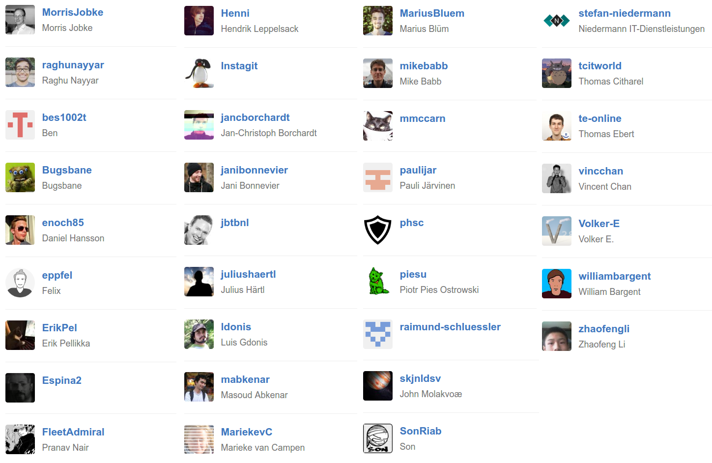
@nextcloud/designers

Slide 5
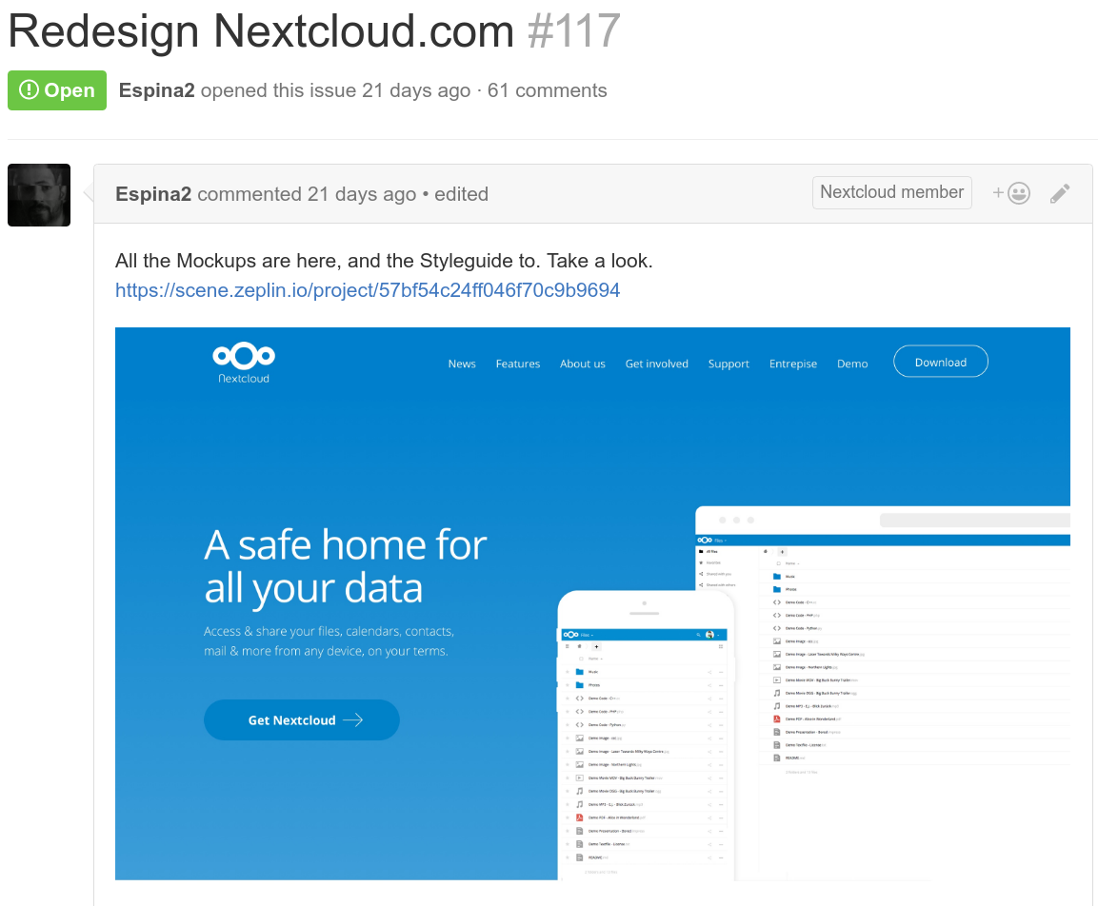
Current: Website

Slide 6
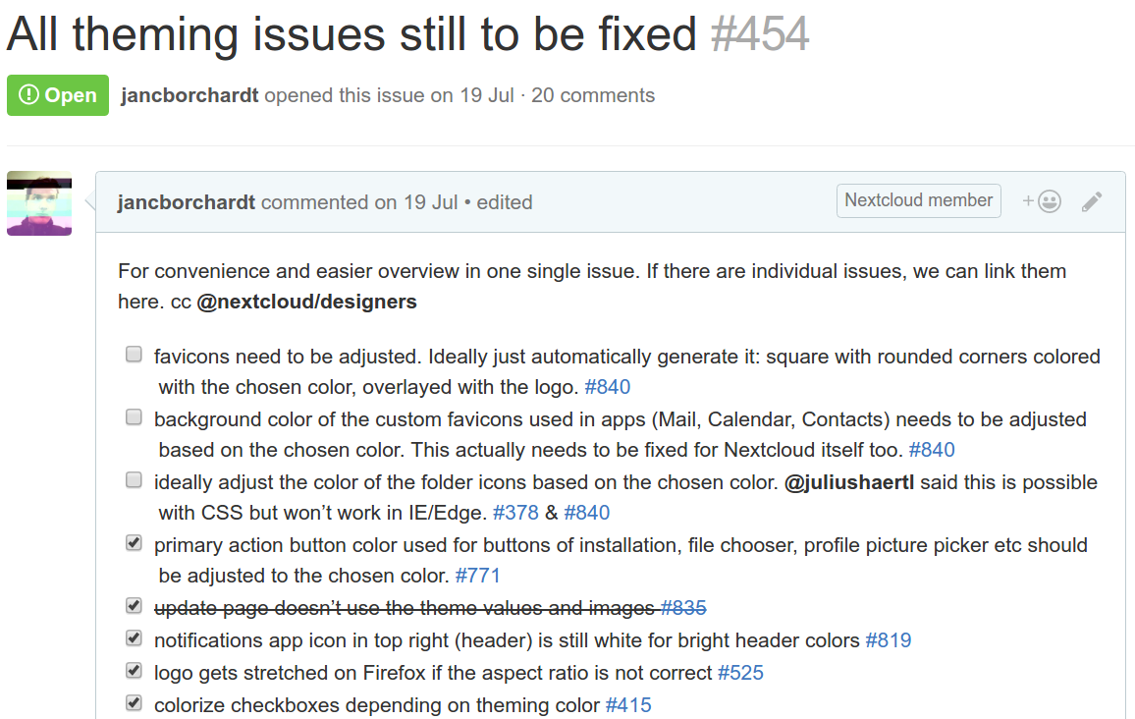
Current: Theming

Slide 7
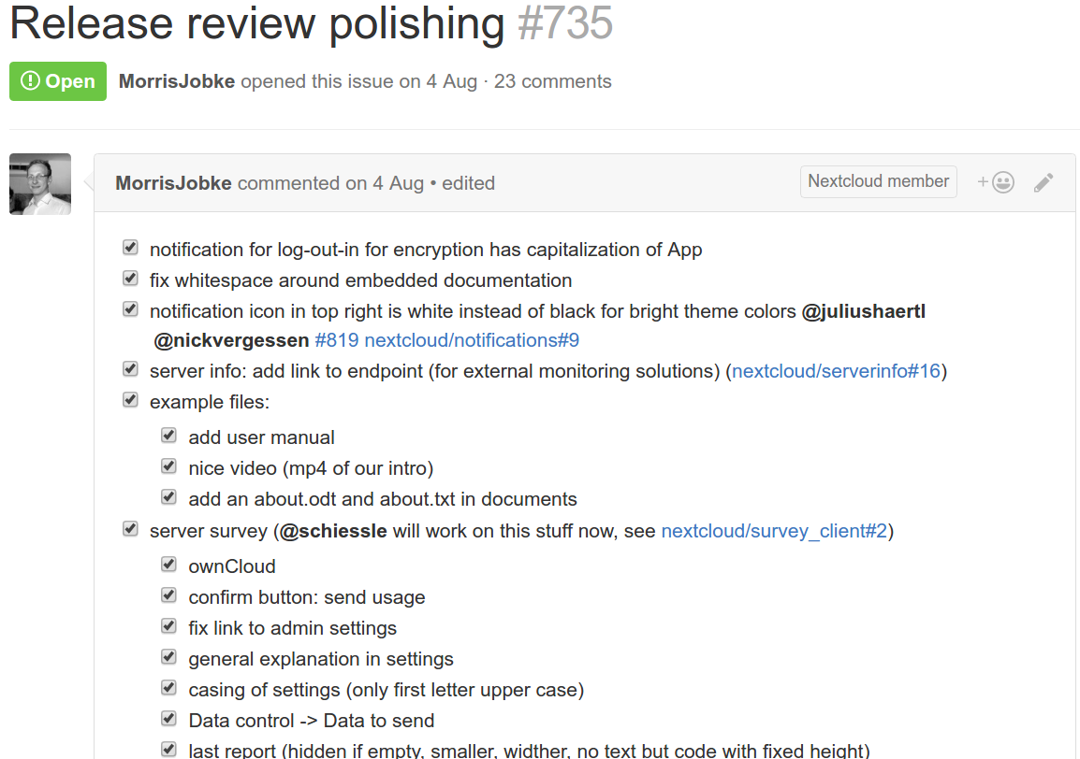
Current: Polishing

Slide 8
Workshop tomorrow 13:30

